Slide 1


Logging
Nemanja Đorđević
Ivan Lazarević

Slide 2


What is logging?
Wikipedia
Logging is the act of keeping a log. In the simplest case, messages are written to a single logfile.
Happy programmer
Better logs => better quality applications => more happiness all around
Do not let your code burn!

Slide 3
Microsoft Logging
https://github.com/aspnet/Logging
Microsoft.Extensions.Logging.Abstractions
Microsoft.Extensions.Logging
Microsoft.Extensions.Logging.Console
Microsoft.Extensions.Logging.Debug
Microsoft.Extensions.Logging.EventLog
Microsoft.Extensions.Logging.Filter
Microsoft.Extensions.Logging.TraceSource
Intense development on dev branch

Slide 4
Lab excercise: MEL Basics

Slide 5
Lab excercise: ASP.NET Core Integration

Slide 6
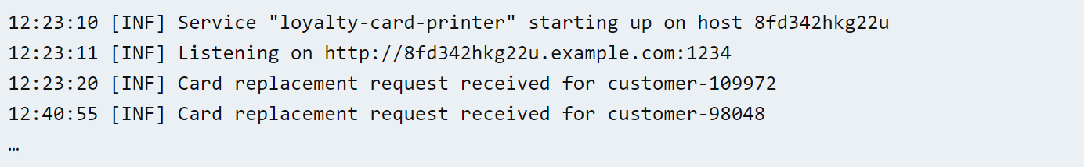
Text Logging
Text logging, sometimes also called ‘printf debugging’ after the C printf() family of functions, is the first one most programmers encounter. As your code executes, it prints lines of text out to the terminal that describe what’s going on.

Slide 7
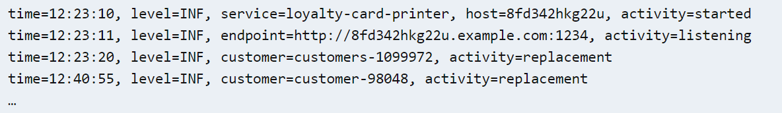
Structured Logging
Structured logging is an umbrella term for alternatives focusing on easier searching and analysis at scale. A structured log event, rather than being a line of text, is conceptually a timestamped set of name/value properties.
Structured logging systems separate the way the event is captured (the logging API) from the way that it is transported (perhaps JSON) and how it is rendered in a user interface or file.

Slide 8
Structured Logging
Properties in the event are first-class: a log server can return results for a query like activity == "replacement" && customer == "customer-98048" without any configuration to describe how the events should be parsed.
Text logs can provide some structure by encoding well-known fields like the timestamp, logging level and thread id at the start of each line, and by including name=value formatted fields in the message itself
Structured logs sometimes look a lot like text logs when formatted out to a flat file or the terminal, and often include a message field that is itself free text

Slide 9
Benefits of Structured Logging vs Text logging
When you write two events with log4net like:
log.Debug("Disk quota {0} exceeded by user {1}", 100, "DTI-Matt");
log.Debug("Disk quota {0} exceeded by user {1}", 150, “buda");
These will produce similar text:
Disk quota 100 exceeded by user DTI-Matt
Disk quota 150 exceeded by user buda
As far as machine processing is concerned, they're just two lines of different text.
You may wish to find all "disk quota exceeded" events, but the simplistic case of looking for events like 'Disk quota%' will fall down as soon as another event occurs looking like:
Disk quota 100 set for user DTI-Matt

Slide 10
Benefits of Structured Logging vs Text logging
By contrast, when you write the following two Serilog events:
log.Debug("Disk quota {Quota} exceeded by user {Username}", 100, "DTI-Matt");
log.Debug("Disk quota {Quota} exceeded by user {Username}", 150, "nblumhardt");
These produce similar text output to the log4net version, but behind the scenes, the "Disk quota {Quota} exceeded by user {Username}" message template is carried by both events.
With an appropriate sink, you can later write queries where MessageTemplate = 'Disk quota {Quota} exceeded by user {Username}' and get exactly the events where the disk quota was exceeded.

Slide 11
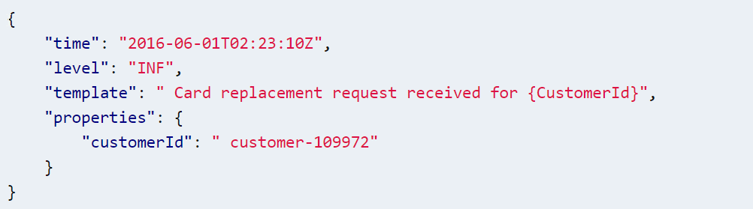
Logging with message templates
// var customerId = "customer-109972";
Log.Information("Card replacement request received for {CustomerId}", customerId);
The description of the event, called the message template, uses named ‘holes’ instead of the anonymous {0} and {1} numeric placeholders found in .NET format strings.
Under the hood, instead of immediately substituting the value of customerId into the template to create a text event, the logging library captures the template and the argument values individually

Slide 12
Lab excercise: SEQ

Slide 13
Thank you for your attention

